Slide 1

9Meal Food Delivery

Slide 2

Our Team
Nguyễn Hữu Dương
Phong Thanh Nhi (Leader)
Nguyễn Huỳnh Vân Anh
Ngô Bỉnh Quyền
Lê Thị Cẩm Như

Slide 3
Table of contents
01
02
03
Project goals
Stakeholders & app features
Use case diagram

Slide 4
01
Project goals

Slide 5
Project goals
Connecting local restaurant with everyone
Choose and order your favorite foods
Fast devlivery to the orderer

Slide 6
02
Stakeholders & app features

Slide 7
Stakeholders
Admin
Restaurant
Shipper
Orderer (end-user)
Payment

Slide 8
App features
Restaurant
Content management: menu, images, pricing...
Order management
Communicate with shipper
Shipper
Sign up
Order status and pick up management
Communicate with orderer
Ordered
Sign up
Personal profile
Restaurant search
Orders
Payment

Slide 9
03
Use case diagram

Slide 10
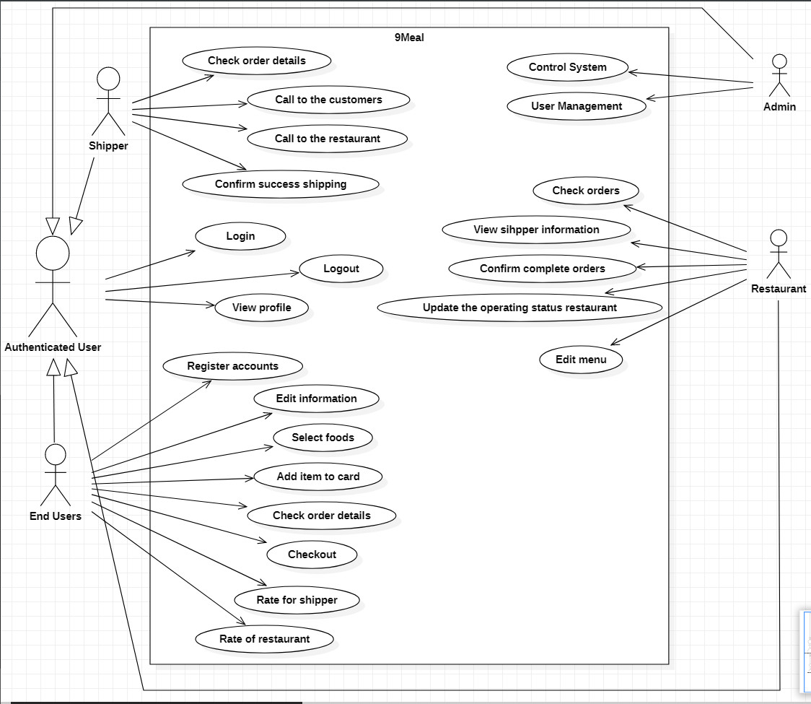

Slide 11
Thanks
Do you have any questions?

